Slide 1


Team 18: Kubernetes
Based Attacks
Bi-Weekly Update 4 Thomas Gumienny, Patrick Churchill, Albert Ma Sponsor: Sandip Roy TA: Sabyasachi Gupta
Notes:
Michelle

Slide 2
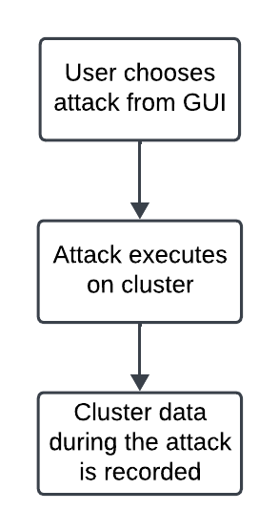
Project Summary
The US Navy is using Kubernetes to manage software. However, as a relatively new cyberservice, Kubernetes has a variety of cybersecurity weaknesses.
Develop a Kubernetes testbed that can simulate and collect the data of common types of attacks, and can also serve as a way to run more attacks
Notes:
Kyle

Slide 3
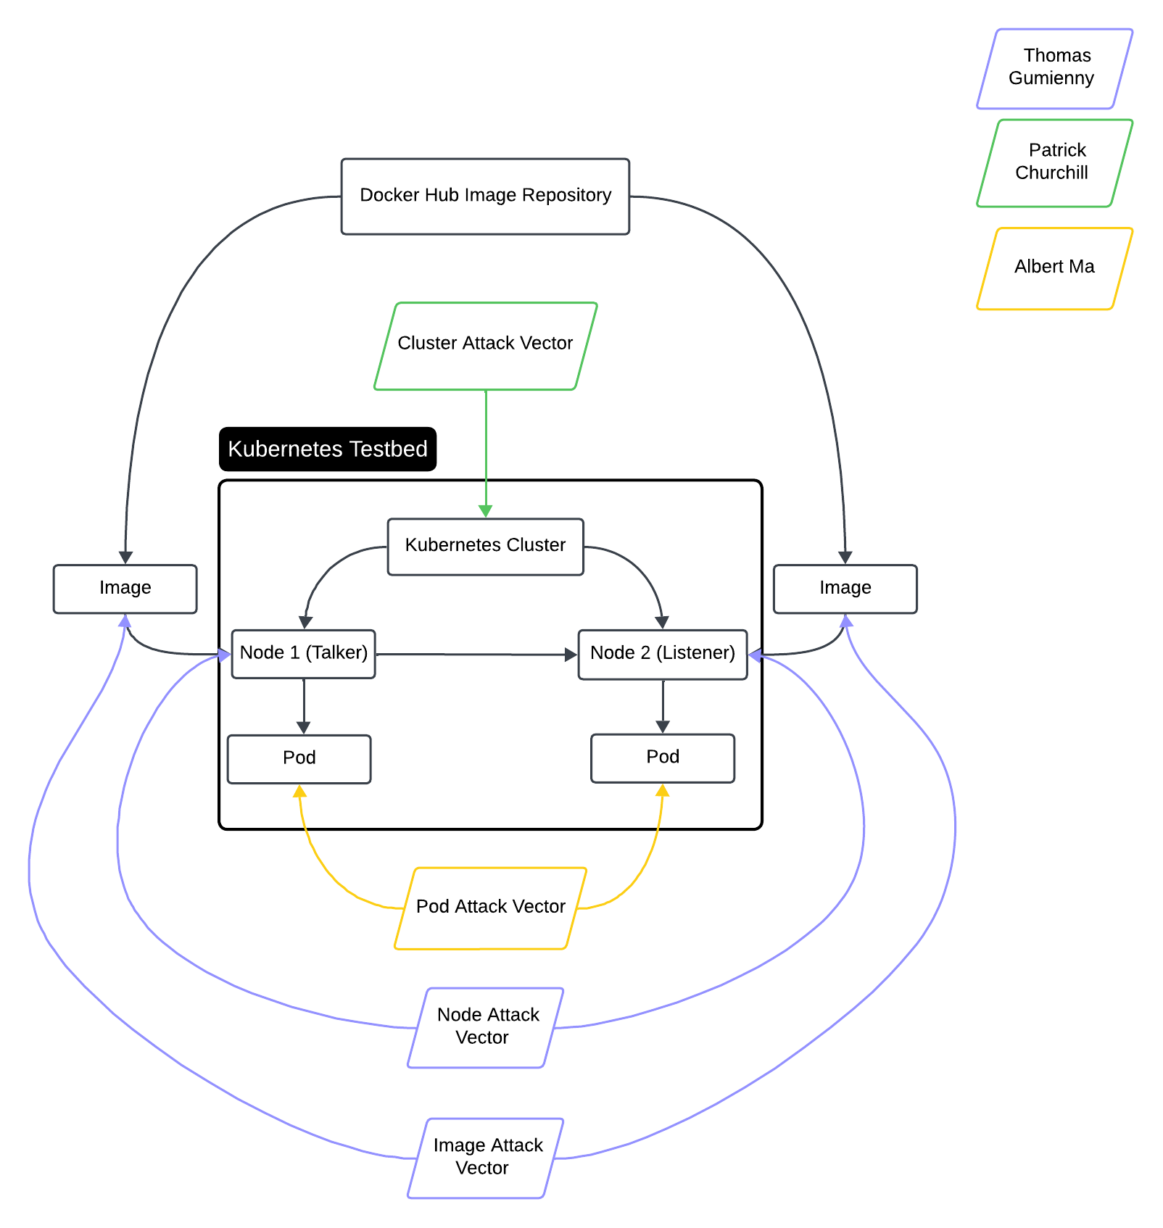
Project/Subsystem Overview
Thomas Gumienny - Image Attack
Image has similar name to normal docker image
When run, image consumes CPU/GPU resources
Albert Ma - Pod Attack
Set up target pod, and conduct reconnaissance on network
Gain access to target pod and container and all stored info
Patrick Churchill - Cluster Attack
Server Node applies pods upon Agent Node that overload the memory and CPU on Server Node, causing it to crash
Notes:
Eric

Slide 4
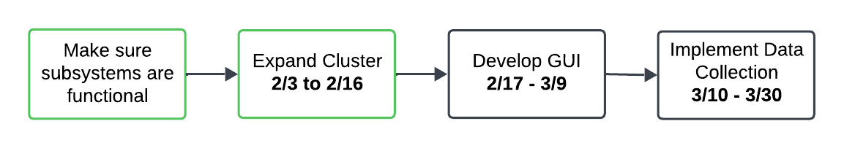
Project Timeline
Notes:
Eric

Slide 5
Image Attack Vector
Thomas Gumienny
Accomplishments since 2/19 15 hrs of effort | Ongoing progress/problems and plans until the next presentation
Node Attack can be run via button Netflow data gathering pod added to cluster Netflow capture added to GUI | Make it so my attack does not freeze GUI while running Make GUI look nicer

Slide 6
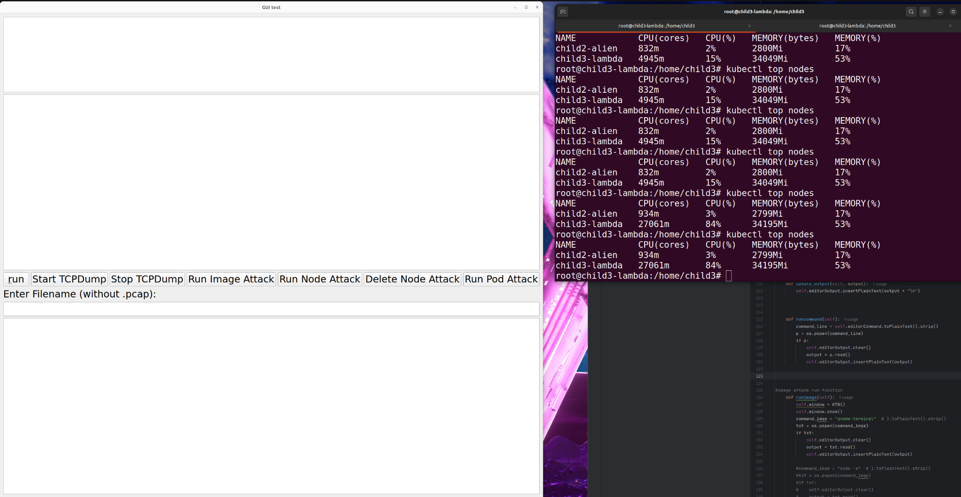
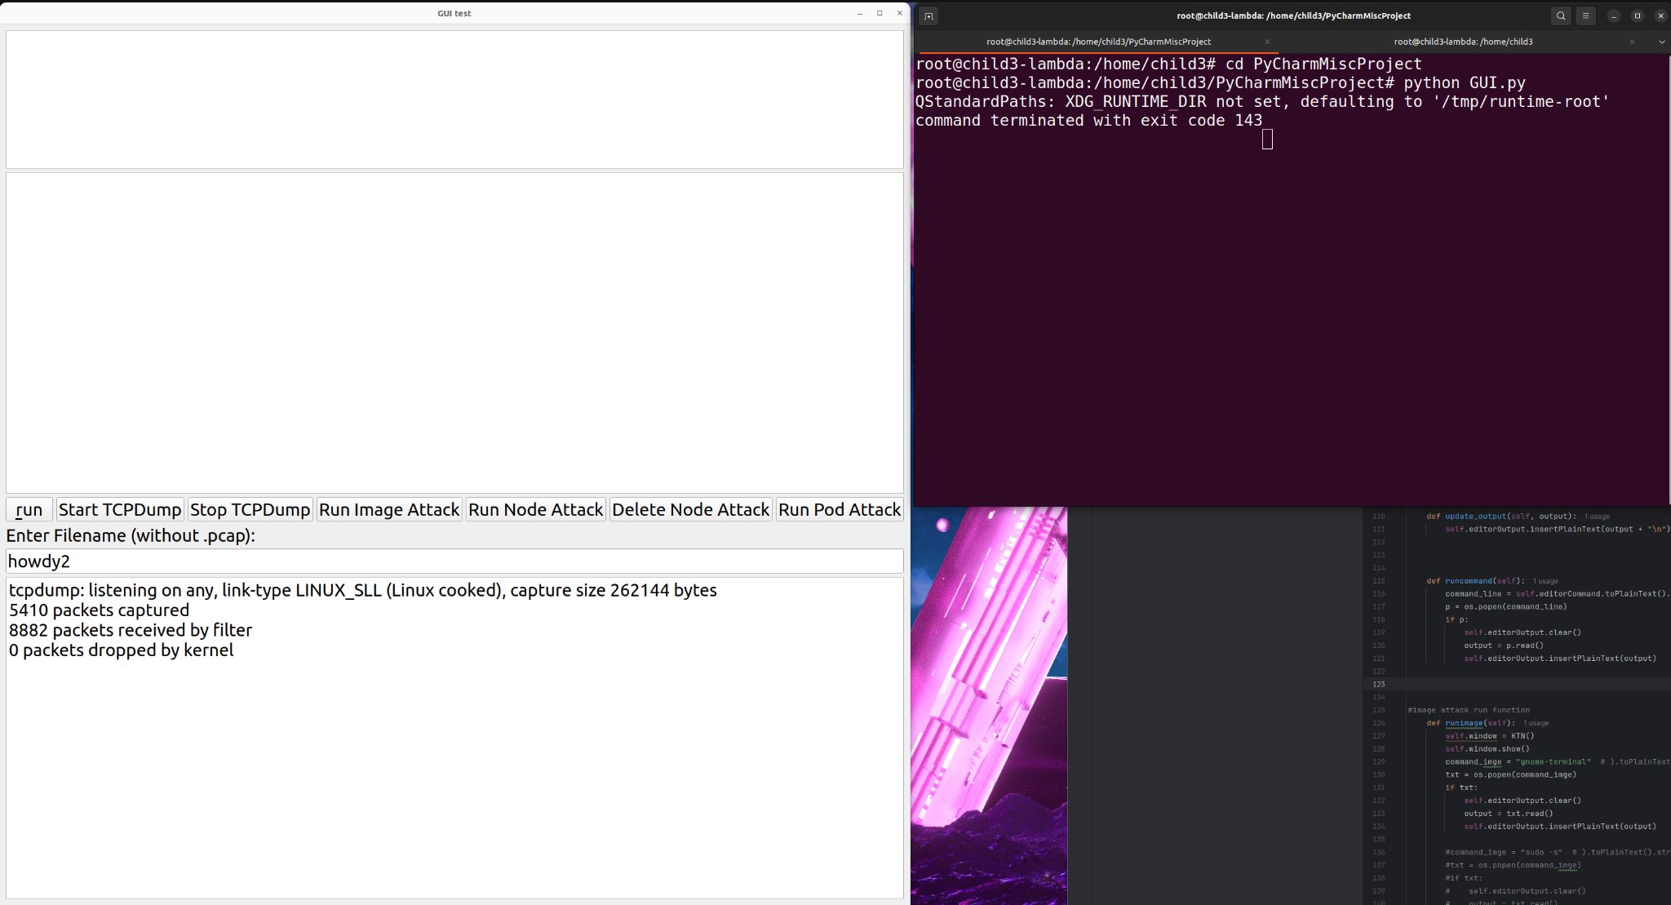
Image Attack Vector
Thomas Gumienny

Slide 7
Image Attack Vector
Thomas Gumienny

Slide 8
Node Attack Vector
Patrick Churchill
Accomplishments since 2/19 14 hrs of effort | Ongoing progress/problems and plans until the next presentation
Installed “Run Node Attack” button on GUI and successfully implemented attack Installed “Delete Node Attack” button on GUI and successfully deleted attack | Include live statistics and measurements on GUI while attack is ran Cleaning up GUI interface to be more presentable

Slide 9
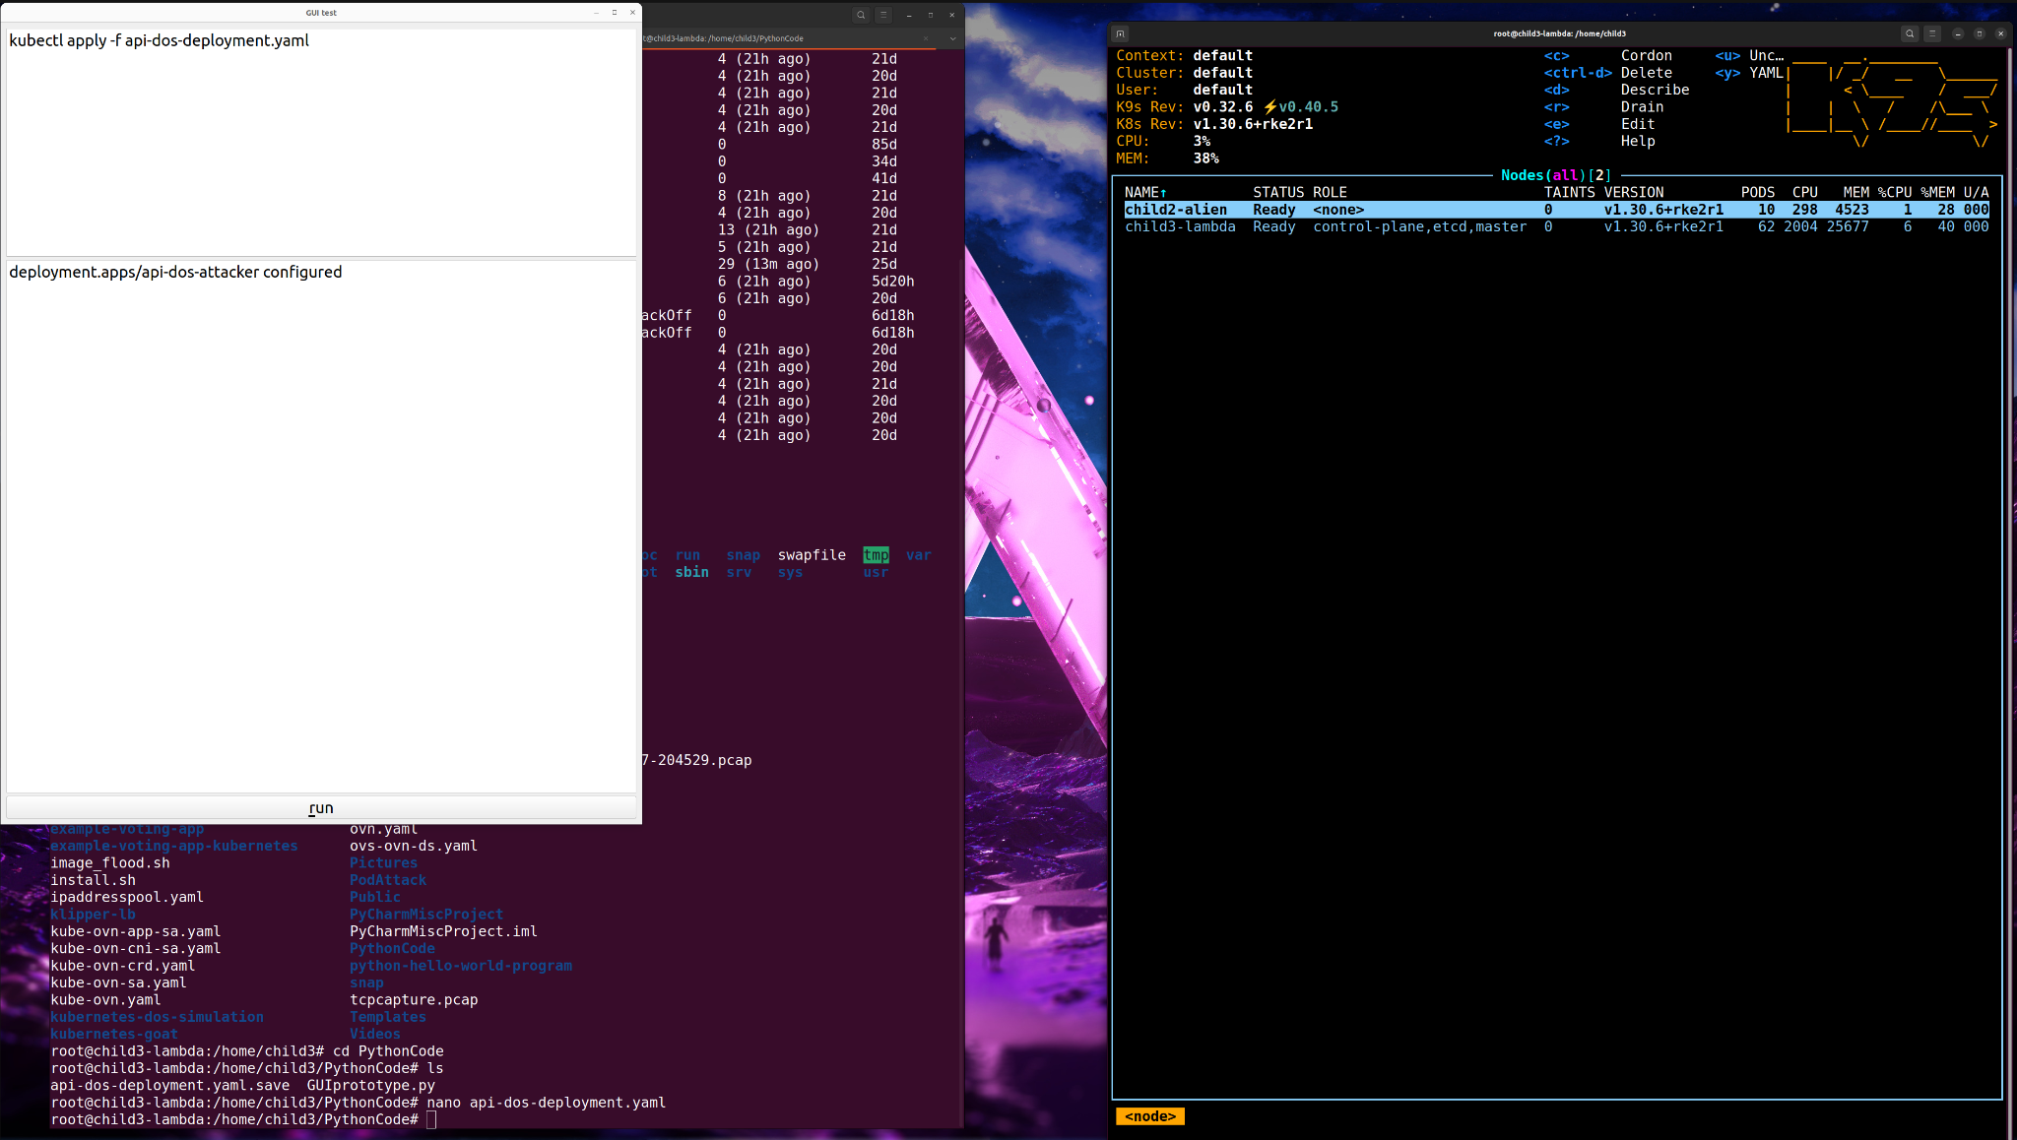
Node Attack Vector
Patrick Churchill

Slide 10
Pod Attack Vector
Albert Ma
Accomplishments since 2/19 15 hrs of effort | Ongoing progress/problems and plans until the next presentation
Developed a bash script that spam creates large containers (50 GB) for a target pod Up to 96% CPU consumption and 25% memory usage Integrated the script to the GUI, able to successfully execute from the GUI | Add a “kill switch” for the script on the GUI Test the unified env var update script on a random pod

Slide 11
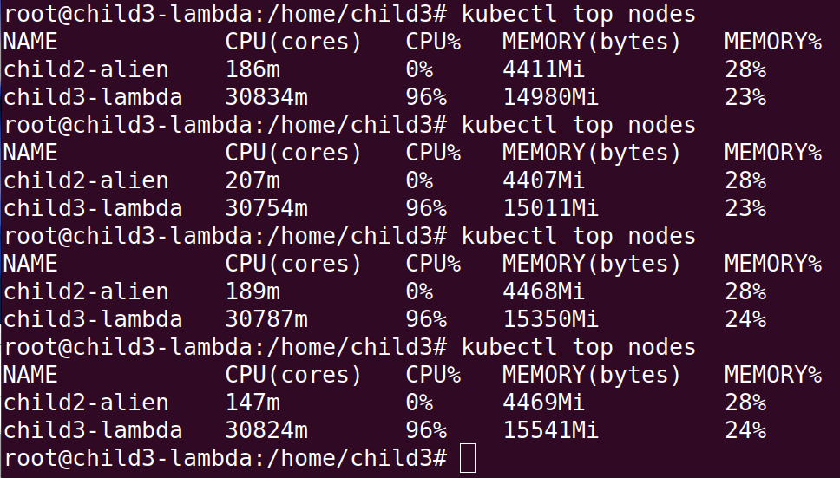
Pod Attack Vector
Albert Ma

Slide 12
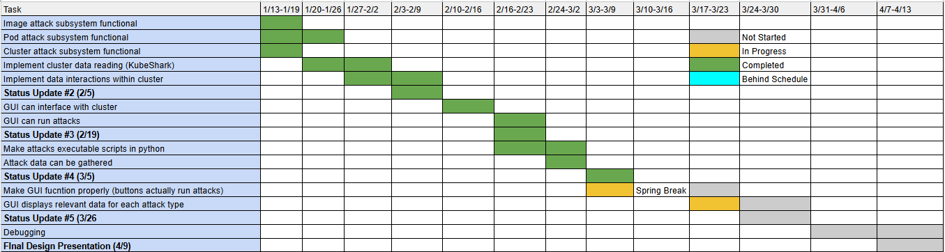
Execution Plan
Notes:
Michelle

Slide 13
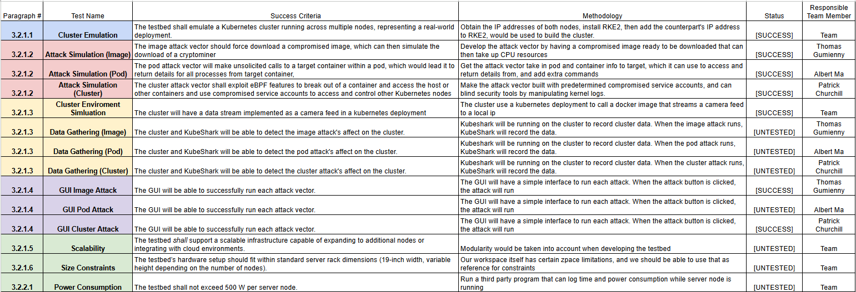
Validation Pan
Notes:
Michelle

Slide 14
Thank You

